Slide 1
Week 8 Tutorial
Libraries
Advanced Functions
Lambda, Map, Filter
Types of errors
Syntax, Runtime, Logic Errors
COMP10001 – Foundations of Computing
Semester 1, 2025
Clement Chau

Slide 2
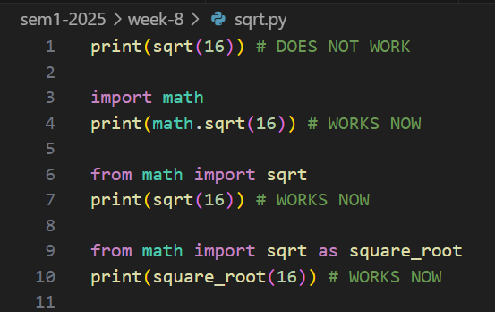
Revision: Libraries
A library is a collection of code designed to be reused in different programs
Libraries tend to contain basic functionality for a particular specialized purpose
e.g. Maths, Generating Plots (Diagram) in Python
Common ones we use in this subject:
math (for functions like sqrt(), log10(), factorial(), and constants like pi, e)
collections (for functions like defaultdict())

Slide 3
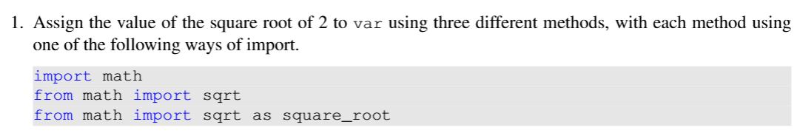
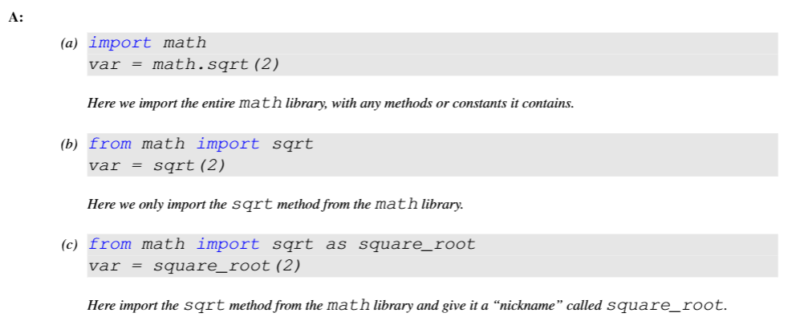
Exercise 1 / 4
Answer:

Slide 4
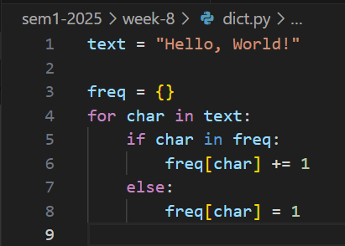
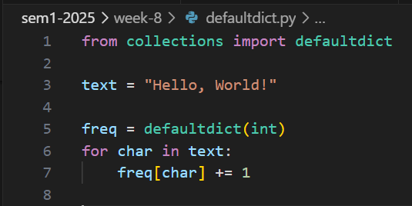
Revision: defaultdict
Without defaultdict
With defaultdict

Slide 5
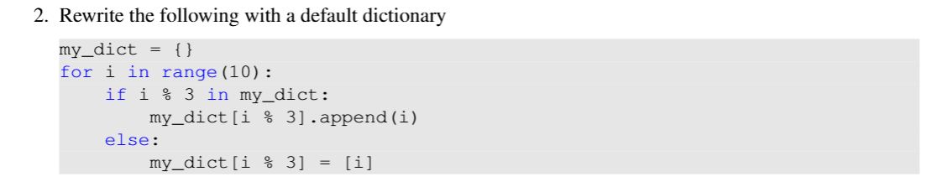
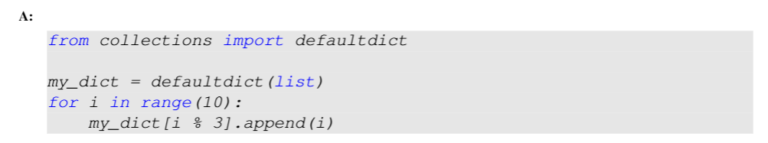
Exercise 2 / 4
Answer:

Slide 6
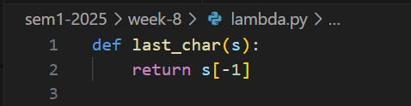


Revision: Lambda functions
Sort the list of animals according to their last character.

Slide 7

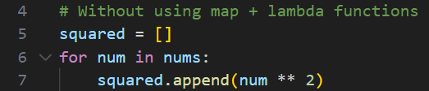
Revision: Map

Slide 8

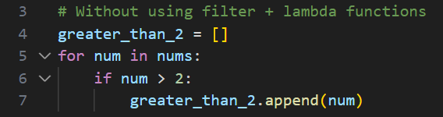
Revision: Filter

Slide 9
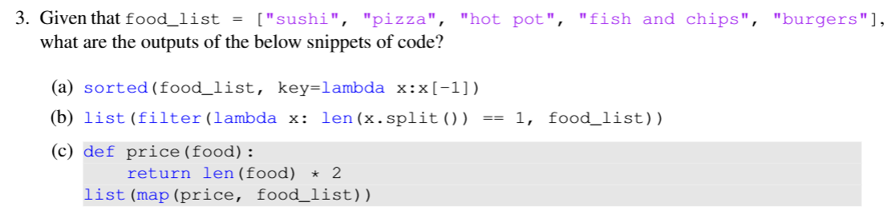
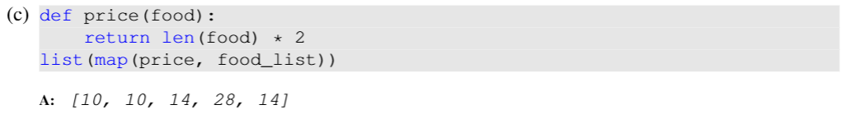
Exercise 3 / 4
Answer:

Slide 10
Revision: Types of errors
Syntax Errors
if statements without the colon ( : ) at the end.
Unmatched brackets (e.g. an opening bracket without a closing bracket)
Runtime Errors
IndexError
TypeError
KeyError
ZeroDivisionError
NameError
AttributeError
Logic Errors
Simply, when your program is not getting the expected output.
Hardest to debug, because the compiler shows no error feedback!

Slide 11
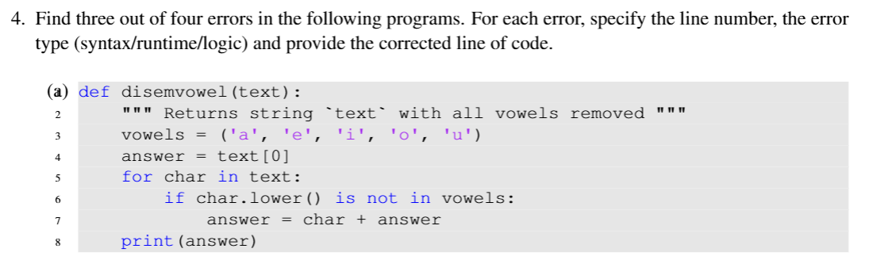
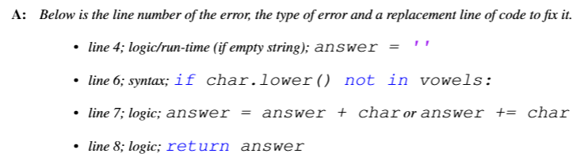
Exercise 4 / 4, part (a)
Answer:

Slide 12
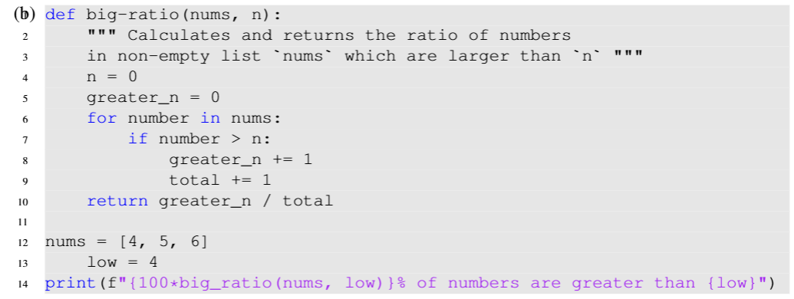
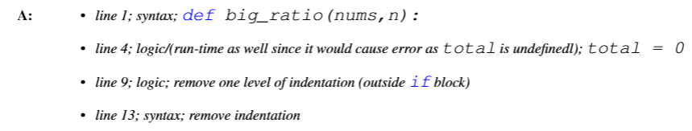
Exercise 4 / 4, part (b)
Answer:

Slide 13


Programming on Paper

Slide 14
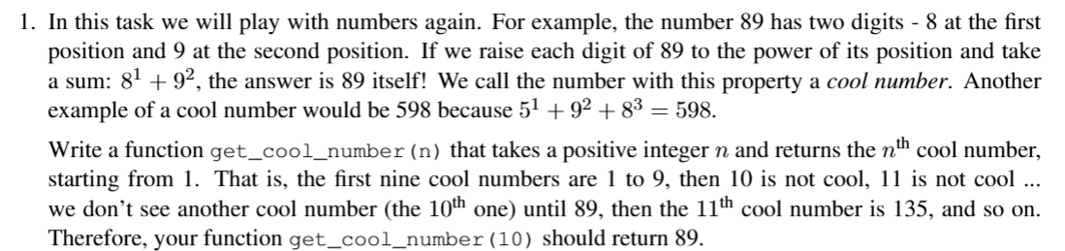
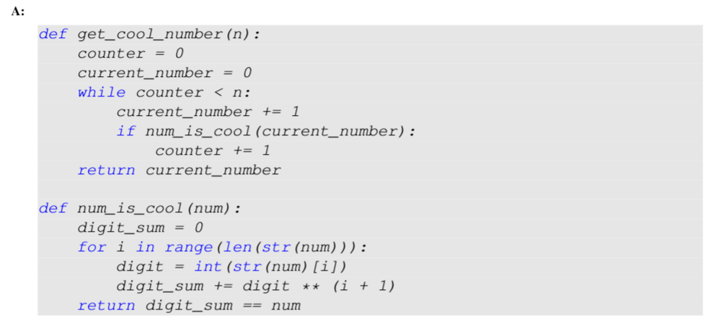
Tip: Use a helper function if needed!
Answer:

Slide 15
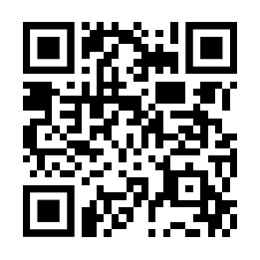
Independent Work
Next due dates:
Your Project 1 is due this Friday, May 2nd, 6pm.
For any questions, please go to the First Year Centre 12pm-2pm every weekday in Level 3, Melbourne Connect or ask in the Ed Discussion Forums!
We can only provide very limited, general guidance.
Ed Worksheets 12 and 13 is due next Monday, May 5th, 6pm.
Your MST marks should be available now.
If you'd like to argue about your marks, please fill in the form in Canvas.
Scan here for annotated slides

